Slide 1
Smart Schools Bond Act
Changes to the Smart Schools Investment Plan

Slide 2
Changes to the SSIP
Questions added/altered to implement new, additional nonpublic educational technology loan requirement for certain transportable School Connectivity items.
Revised SSIP Sections
Overview
School Connectivity
Classroom Learning Technology
New SSIP Section
Nonpublic schools

Slide 3
Overview
Question #5 asks districts if they contain nonpublic schools. #5a also requires districts to identify those nonpublic schools that have closed or moved since 2014-2015, including the enrollment number and their old and new locations.

Slide 4
Overview
Question #12 provides districts with their public, nonpublic and total enrollment numbers, along with their nonpublic percentage. This section will already be computed by the system based on the official data on file with the Department; it will not be editable.
If there are questions regarding the data displayed, please review the Office of Information Technology Services’ website http://www.p12.nysed.gov/irs/.

Slide 5
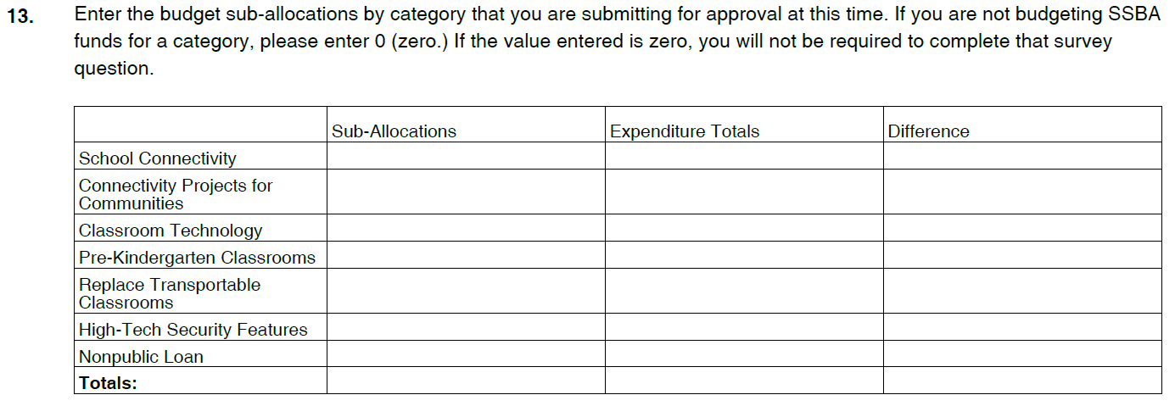
Overview
Question #13 will automatically populate the sub-allocation amounts by category, based on the entries in each category, now including the new category for nonpublics. The system will compare the amount that is allocated in each category budget table to the expenditures total, and the difference between the two columns will identify any data entry errors which need to be resolved prior to submitting the Plan.

Slide 6
School Connectivity
Districts must now differentiate those expenditures that are loanable (transportable) and those that are non-loanable (fixed assets.) The loanable expenditures will be included in the final calculation of the nonpublic loan amount in the new section.
Eligible Nonpublic Items
Computer Servers
Storage devices
Routers/Gateway Appliances
Firewalls/Security devices
Switches
Wireless Access Points and Attached Antennae
Controllers
Modules
Transceivers
Power supply devices, connectors, terminals and power cords purchased specifically for an SSBA device included in the current application.

Slide 7
School Connectivity
Districts must now differentiate those expenditures that are loanable (transportable) and those that are non-loanable (fixed assets.) The loanable expenditures will be included in the final calculation of the nonpublic loan amount in the new section.
Ineligible Nonpublic Items
Visit http://www.p12.nysed.gov/mgtserv/smart_schools/ for additional information
Cabling/Fiber | Installation
Configuration fees | Licenses
Construction | Software
Consultant fees | Other operational costs

Slide 8
School Connectivity
Question #9 asks for those that are loanable (which will be used to calculate the nonpublic loan amount) and asks districts to specify the item, quantity, cost and total cost of all items.

Slide 9
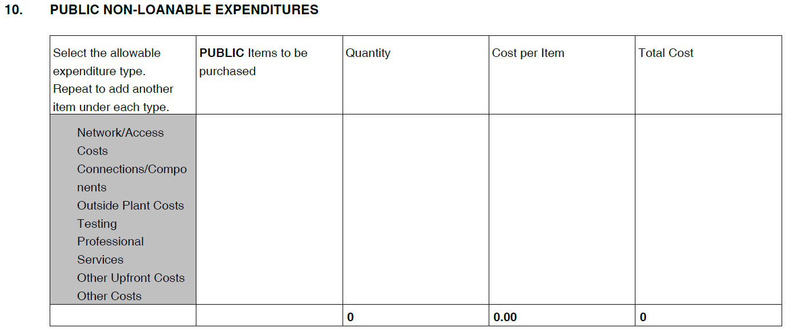
School Connectivity
Question #10 asks districts to detail those items that are non-loanable (which will not be used to calculate the nonpublic loan amount). Non-loanable items consist of installation costs, software, licenses, cabling or other professional services. Districts must specify the item, quantity, cost and total cost of all items.

Slide 10
School Connectivity
Question #11 again provides districts with their public, nonpublic and total enrollment numbers, along with their nonpublic percentage. This section will already be computed by the system; this is only here to assist districts when filling out their SSIP.

Slide 11
School Connectivity
Districts must now also complete two different budgets for the total loanable and non-loanable items. Question #12 asks districts to enter the budgeted total of loanable items that are for public schools. The system will then calculate, based on the above enrollment data, the estimated nonpublic loan amount and the total public and nonpublic budget amount for each sub-allocation and for the total School Connectivity budget.

Slide 12
School Connectivity
Question #13 asks districts to complete the non-loanable budget amount for each sub-allocation.

Slide 13
School Connectivity
Question #14 will calculate and display the total budget, differentiating those allocations that are for loanable versus non-loanable items.

Slide 14
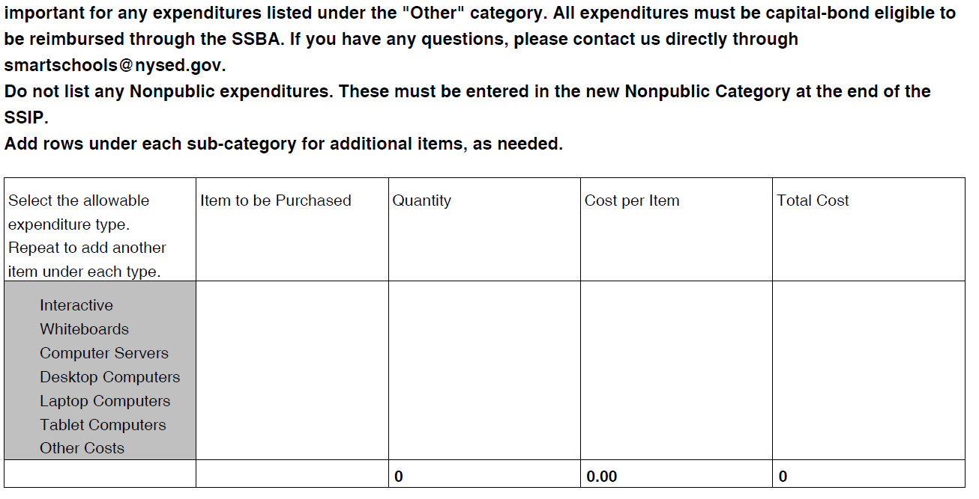
Classroom Learning Technology
Question #12 asks districts to identify their public expenditures. Districts must differentiate the item, quantity, cost and total cost for each item.
Note that nonpublic expenditures do NOT get listed in this table. They will be entered in the new nonpublic section. If you included them previously, they should be moved there.

Slide 15
Classroom Learning Technology
Question #13 again provides districts with their public, nonpublic and total enrollment numbers, along with their nonpublic percentage. This section will already be computed by the system; this is only here to assist districts when filling out their SSIP.

Slide 16
Classroom Learning Technology
Question #14 asks districts to complete their Public sub-allocation for each sub-category.
The system will use those sub-allocations to estimate the nonpublic loan amount by sub-category based on the enrollment figures in #13 and sum to the total nonpublic loan share attributable to Classroom Learning Technology.

Slide 17
Nonpublic Schools
Question #1 asks districts to describe their plan to loan purchased hardware to nonpublic school(s) within the district. Please include the per-student loan amount and the technology requested.
1. Describe your plan to utilize SSBA funds to purchase devices and loan to the nonpublic schools within your district. Please specify what devices have been requested by the nonpublic schools. If the nonpublic schools have not finalized requests, the district should provide the date nonpublic schools will submit the request by.

Slide 18
Nonpublic Schools
Question #2 asks districts to certify that they have conferred with their nonpublic school(s) and determined a date they must request technology. #2a asks districts to provide the date nonpublic schools must request the items.

Slide 19
Nonpublic Schools
Question #3 again provides districts with their public, nonpublic and total enrollment numbers, along with their nonpublic percentage. This section will already be computed by the system; this is only here to assist districts when filling out their SSIP.

Slide 20
Nonpublic Schools
Question #4 collects all of the data from the School Connectivity and Classroom Learning Technology Categories related to the nonpublic loan. This table will import the nonpublic allocation and the estimated per-pupil and total loan amount for each category.
The optional entry, which should be entered only in the cell in the bottom row, is to allow for an additional loan amount out of the district’s SSBA allocation, if desired. However, as with each step of the nonpublic loan calculations, the cumulative loan amount across all categories and SSIPS can be no more than $250 per pupil in total.
The table then will import the same data for previously approved plans, including any amount received from the $25 million supplemental nonpublic loan amount, if applicable. It will then provide the final total per-pupil and total nonpublic loan amounts.

Slide 21
Nonpublic Schools
Question #5 will summarize the final per-pupil and total loan amounts from previously approved plans and this plan. The total amount of all nonpublic loan amounts are shown at the bottom and will be capped at $250 per pupil, total.

Slide 22
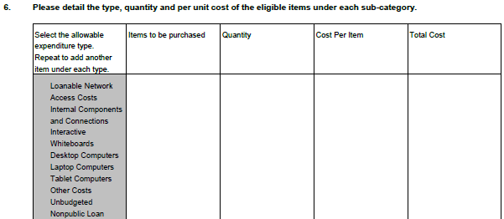
Nonpublic Schools
Question #6 asks districts to identify those expenditures in the school connectivity and classroom technology categories that are for nonpublic use. Districts must include the item, quantity, cost and total cost of each item.

Slide 23
Eligible Nonpublic Expenditures
While the calculation of the total amount of a nonpublic school’s loan is based upon the specific items the public school district plans to purchase for its students, in both School Connectivity and Classroom Learning Technology, the nonpublic schools can request any eligible item (other than non-transportable equipment) under both categories.
Eligible Nonpublic Items
Antennas - Attached | Mice, headphones & keyboards
Cables & connectors - Integral to Hardware | Modules & components
Cameras | Mounting equipment & stands
Carts and cabinets- Charging & storage | Power supply, connectors & backup
Chromebooks | Printers (non-3D)
Computer servers | 3D printers & laser engravers
Controllers | Projectors
Desktop computers | Robotics
Firewalls/security appliances | Routers/gateway appliances
Hardware extended warranties | Storage devices
Indoor or Outdoor wireless access points | Switches
Interactive whiteboards | Tablet computers
Laptop computers | Other costs (Transportable only)
Machinery

